Slide 1
FoxCore Retail
Database Design Project
GROUP 4 MEMBERS Vinutha Chelamallu
Hsiao Tien (Tammy) Chow
Somya Garg
Ta-Chin (Meek) Ho
Sai Pradeep Vallabhaneni

Slide 2

Agenda
Background
Origin and Growth
Challenges
Constraints
Creation of Database
Conceptual
Logical
Physical
Scripts for Database Design

Slide 3
Origin and Growth of FoxCore
A small retail business across Ontario founded by Liam Corrigan and Mitchell Fox.
Selling inexpensive novelty items : Bubble Guns and Arctic Skin Cooling Towels, which Fox had previously built a relationship with the owner.
As sales grew, they hired salespeople to handle the high demand and added new products such as emoji pillows, heating pads, and remote-controlled drones, while figuring out which products worked best at different shows.
Foxcore had expanded. Corrigan and Fox managed up to three shows per weekend, with multiple booths at some venues.

Slide 4
Challenges
Data Fragmentation
Data Analysis Limitations
Inaccurate Sales Tracking
Information spread across multiple spreadsheets made routine business operations difficult and lacked strategic insights.
Inability to access and analyze essential data hindered optimal decision-making for both immediate and future planning.
Consultants failed to record all sales, leading to lost commissions and unreliable inventory estimates due to unclear sales records.

Slide 5
Constraints
Time
Budget
Required a quick and effective solution in less than 30 days before the festival season began
Foxcore struggled to set appropriate costs and prices due to rising expenses and needed efficient, cost-effective solutions quickly.

Slide 6
Let’s Create a DataBase!
- Focus: Designed to track events, sales, salespersons, venues, products, and booths.
- Purpose: Protect business records from constraints and ensure operational efficiency.

Slide 7
Conceptual Database Design
Identify Entities and Relationships: Define the entities and relationships in the database.
Attribute Listing: List attributes for each entity to structure the data effectively.
Reduce Redundancies and Inconsistencies: A well-designed conceptual database minimizes data redundancies and inconsistencies.

Slide 8
Description & Relationships of attributes
Entity | Attributes | Description | Relationships
Venue | Venue ID(primary key),Venue Name,Street Address,City,State/Province,Postal Code,Description | Information about the venue where events are held. | One Venue can host Many Events
Event | Event ID(primary key), Venue ID(foreign key),Event Name,StartDate,EndDate,Description,EventType | Details about the event. | One Event can have Many Booths One Event can have Many Sales
Booth | Booth ID(primary key), Event ID(foreign key),Location | Information about a booth within a specific event. | One Booth can have Many Sales
Product | Product ID(primary key),ProductName,WholeSale Code,Minimum Selling Price | Details about a product sold at events. | One Product can be sold in Many Sales
SalesPerson | SalesPerson ID(primary key), FirstName,LastName,Street Address,City,State/Province,Postal Code,Phone Number | Information about the salesperson | One Salesperson can work Many Shifts (Sales) One Salesperson can work many Shifts
Sales | Sales ID(primary key),Event ID(foreign key),Shift ID(foreign key),Product ID(foreign key),Quantity Sold,Selling Price,Sale Date | Details about a specific sales transaction | Associates product and salesperson
Shift | Shift ID(primary key),SalesPerson ID(foreign key), Booth ID(foreign key),StartTime,EndTime | Information about a salesperson's work schedule at a specific booth during an event. | One Shift is assigned to one Booth

Slide 9
Primary Key & Foreign Key (Enity : Venue / Product / Event / Salesperson)
Entity | Attributes | Primary Key | Foreign Key | Data Type
Venue | VenueID | VenueID |  | VARCHAR(10)
 | VenueName |  |  | CHAR(20)
 | Street Address |  |  | VARCHAR(100)
 | City |  |  | VARCHAR(25)
 | State/Province |  |  | VARCHAR(15)
 | PostalCode |  |  | INT(5)
 | Description |  |  | VARCHAR(255)
Entity | Attributes | Primary Key | Foreign Key | Data Type
Product | ProductID | ProductID |  | VARCHAR(10)
 | ProductName |  |  | VARCHAR(45)
 | WholeSaleCode |  |  | DECIMAL(10,2)
 | MinimumSellingPrice |  |  | DECIMAL(10,2)
Entity | Attributes | Primary Key | Foreign Key | Data Type
Event | EventID | EventID |  | VARCHAR(10)
 | VenueID |  | VenueID (References Venue.VenueID) | VARCHAR(45)
 | EventName |  |  | DATE
 | StartDate |  |  | DATE
 | EndDate |  |  | VARCHAR(255)
 | Description |  |  | VARCHAR(10)
 | EventType |  |  | VARCHAR(25)
Entity | Attributes | Primary Key | Foreign Key | Data Type
SalesPerson | SalesPersonID | SalesPersonID |  | VARCHAR(10)
 | FirstName |  |  | VARCHAR(25)
 | LastName |  |  | VARCHAR(25)
 | Street Address |  |  | VARCHAR(100)
 | City |  |  | VARCHAR(25)
 | State/Province |  |  | VARCHAR(15)
 | PostalCode |  |  | INT(6)
 | PhoneNumber |  |  | INT(10)

Slide 10
Primary Key & Foreign Key (Enity : Sales/ Booth/Shift)
Entity | Attributes | Primary Key | Foreign Key | Data Type
Sales | SalesID | SalesID |  | VARCHAR(10)
 | EventID |  | EventID (References Event.EventID) | VARCHAR(10)
 | ShiftID |  | ShiftID (References Shift.ShiftID) | VARCHAR(10)
 | ProductID |  | ProductID (References Product.ProductID) | VARCHAR(10)
 | QuantitySold |  |  | INT
 | SellingPrice |  |  | DECIMAL(10,2)
 | SaleDate |  |  | DATE
Entity | Attributes | Primary Key | Foreign Key | Data Type
Booth | BoothID | BoothID |  | VARCHAR(10)
 | EventID |  | EventID (References Event.EventID) | VARCHAR(10)
 | Location |  |  | VARCHAR(255)
Entity | Attributes | Primary Key | Foreign Key | Data Type
Shift | ShiftID | ShiftID |  | VARCHAR(10)
 | SalesPersonID |  | SalesPersonID (References SalesPerson.SalesPersonID) | VARCHAR(10)
 | BoothID |  | BoothID (References Booth.BoothID) | VARCHAR(10)
 | StartTime |  |  | TIME
 | EndTime |  |  | TIME

Slide 11
Logical Database Design
This can be the part of the presentation where you introduce yourself, write your email…

Slide 12
Normalization
Identify
Ensure
Check
Review
Identify entities, relationships, and attributes
Ensure the relations support required transactions
Check integrity constraints
Review logical data model with user

Slide 13
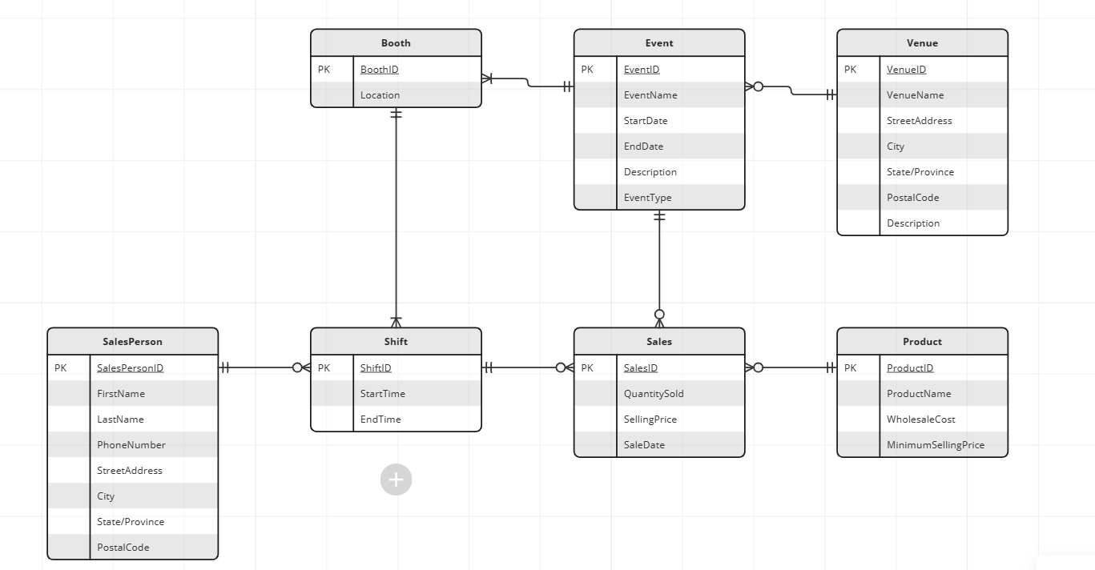
ER DIAGRAM

Slide 14
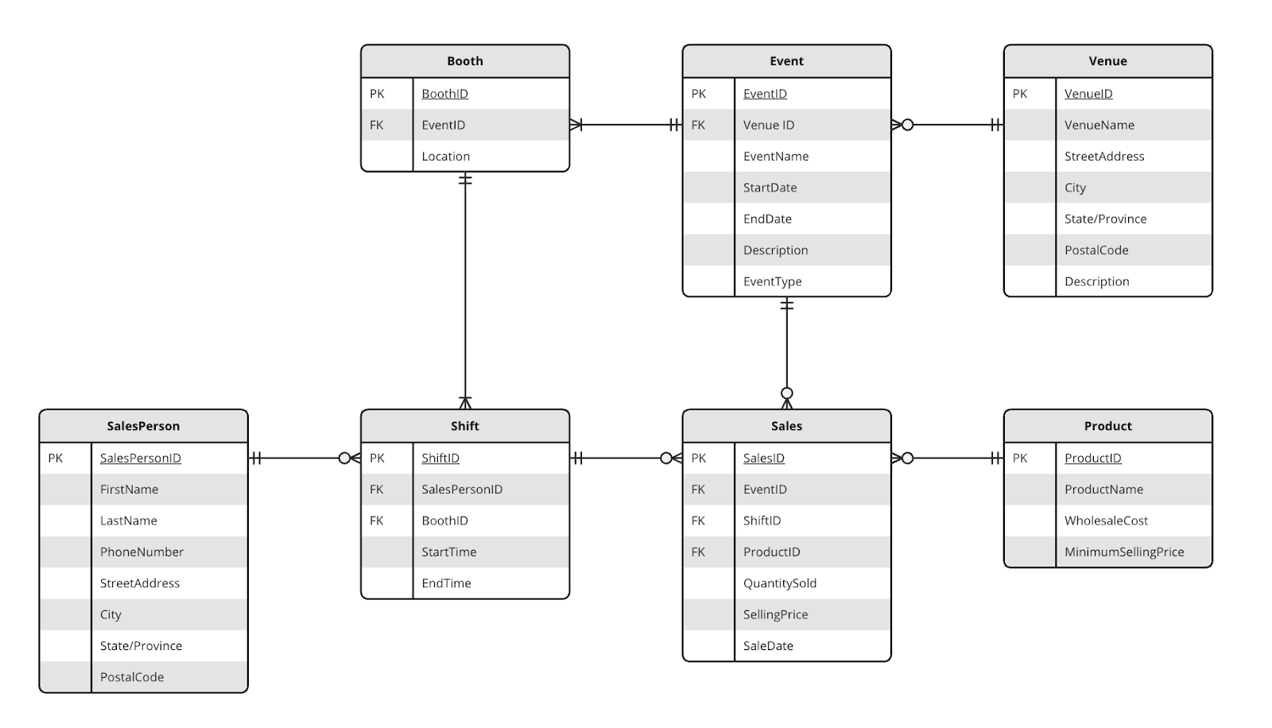
Normalization Schema

Slide 15
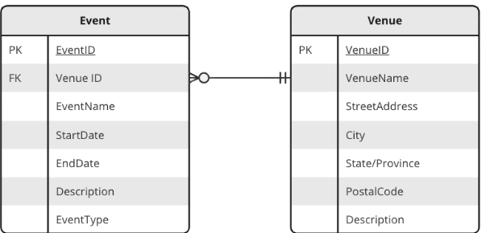


Normalization From ER Diagram
Host

Slide 16
Physical Database Design

Slide 17
Design Base Relations
Primary key uniquely identifies records
Attribute domains specify data types
Required attribute values specified in DDL
General constraints also in DDL
CREATE script defines SQL commands, tables, keys, and constraints.

Slide 18
Scripts for Database Design (Unfinished)
CREATE TABLE Event(
EventID VARCHAR(10) NOT NULL,
VenueID VARCHAR(10) NOT NULL,
EventName VARCHAR(50) NOT NULL,
StartDate DATE NOT NULL,
EndDate DATE NOT NULL,
Description VARCHAR(255),
EventType VARCHAR(25),
CHECK (Eventtype IN ('Trade Show', 'Rib Fest', 'Waterfront festival', 'Music Festival', 'Beer Festival', 'Sporting Event', 'Street Festival')),
PRIMARY KEY (EventID),
FOREIGN KEY (VenueID) REFERENCES Venue(VenueID)
ON UPDATE CASCADE
ON DELETE NO ACTION);
We used NOT NULL for primary key attribute to reject any attempt to insert a null values in the column
The Check in constraint helps us maintain consistency and accuracy in the database by preventing invalid or unexpected data from being entered into the Eventtype column.
The FOREIGN KEY constraint establishes a relationship between the VenueID column in the current table and the VenueID column in another table named Venue.
Notes:
Why we use check in
最後解釋primary key and foreign key

Slide 19
Data Manipulation Language (DML) Statements (V)
INSERT: Insert new data into a table.
INSERT INTO Venue (VenueID, VenueName, StreetAddress, City, State, PostalCode, Description) VALUES ('V001', 'Convention Center', '123 Main St', Toronto, Ontario, '12345', 'Large venue for conventions and trade shows');
UPDATE: Modify existing data in a table.
UPDATE Event SET EventName = ‘FoxCore Summer Festival’ WHERE EventID = ‘E002’;
DELETE: Remove data from a table.
DELETE FROM Product WHERE ProductID = ‘P001’;

Slide 20
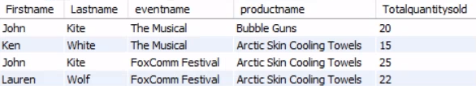
SQL Commands for Database
“The result from the SELECT statement provides the first name and last name of the salesperson, the event name, and the product name. It shows the total quantity of the product sold for each group combination of salesperson ID, event ID, and product ID. The results are grouped by salesperson ID, event ID, and product ID.”
Select sp.Firstname, sp.Lastname,e.eventname, p.productname, SUM(s.quantitysold) AS Totalquantitysold
From sales s
JOIN Shift sh ON s.Shiftid=sh.shiftid
JOIN event e ON e.eventid=s.eventid
JOIN product p ON s.productid=p.productid
JOIN salesperson sp ON sh.salespersonid=sp.salespersonid
Group by sp.salespersonid,e.eventid, p.productid;

Slide 21
Thanks!
Please keep this slide for attribution

Slide 23
9h 55m 23s
333,000
386,000 km
Jupiter’s rotation period
The Sun’s mass compared to Earth’s
Distance between Earth and the Moon

Slide 24
Data collection: best practices
Clarity
Precision
Mars is actually a very cold place
Saturn is a gas giant and has several rings
Privacy
Variety
Mercury is the closest planet to the Sun
Venus has extremely high temperatures

Slide 25


Our team
Alexander Hill
Maria Karla
You can speak a bit about this person here
You can speak a bit about this person here

Slide 26
Data collection vs data analysis
Data collection
Data analysis
Despite being red, Mars is actually a cold place. It’s full of iron oxide dust
Mercury is the closest planet to the Sun and the smallest of them all
Venus has a beautiful name and is the second planet from the Sun
Saturn has several rings. It’s composed mostly of hydrogen and helium
Neptune is the farthest planet from the Sun and the fourth-largest
Jupiter is a gas giant and the biggest planet in the Solar System

Slide 27
Assignment brief
Qualification | Mercury is a small planet
Unit number & tittle | Venus is a hot planet
Learning aim(s) | We all live on Earth
Assignment title | Saturn is a gas giant and has rings. It’s composed mostly of hydrogen and helium
Assessor | Jupiter is a huge gas giant
Issue date | 12/10/2XXX
Hand in deadline | 12/12/2XXX
Scenario | Community health and prevention research relies heavily on the collection and analysis of data to inform effective interventions. In this essay, critically examine the impact of different data collection methods on the success of community health initiatives
Task 1 | Discuss the advantages and limitations of various data collection techniques, such as surveys, interviews, observational studies, and secondary data analysis, and how they influence the development and implementation of prevention strategies

Slide 28
Rubric
 | Level 1 | Level 2 | Level 3 | Level 4
Performance 1 | You can add a description here | You can add a description here | You can add a description here | You can add a description here
Performance 2 | You can add a description here | You can add a description here | You can add a description here | You can add a description here
Performance 3 | You can add a description here | You can add a description here | You can add a description here | You can add a description here
Performance 4 | You can add a description here | You can add a description here | You can add a description here | You can add a description here

Slide 29
Exercise 1
What is the term for the process of ensuring that data collected is accurate and reliable?
In data collection, what is the term for a representative subset of a population?
A | Data analysis
A | Sample
B | Data interpretation
B | Survey
C | Data validation
C | Experiment
D | Data visualization
D | Observation

Slide 30
Exercise 2
Explain what is the difference between data collection and data analysis?
You can answer here
How to unlock the power of data collection and analysis?
You can answer here

Slide 31
What’s the difference?
Data collection
Data analysis
Survey
Descriptive
Mars is actually a very cold place
Jupiter is a huge gas giant
Interview
Inferential
Venus has high temperatures
Mercury is a small planet
Observation
Hypothesis
Earth is the planet with life
Saturn has several rings

Slide 32
Let’s review before wrapping up
Data collection
Data analysis
Information-gathering
Insights-generation
Venus has a beautiful name and is the second planet from the Sun
Despite being red, Mars is actually a cold place. It’s full of iron oxide dust

Slide 33
Icon pack

Slide 34
Alternative resources
Here’s an assortment of alternative resources whose style fits that of this template:
Vectors
Geometric models background in flat design

Slide 35
Resources
Did you like the resources used in this template? Get them on these websites:
Vectors
International nurses day template
Icons
Icon Pack: Research and Development | Lineal
Photos
Student posing during a group study session with colleagues
Friends learning in a study group
Front view smiley man holding laptop
Portrait of senior woman in professional blazer outdoors

